Slide 1
caCORE SDK 4.0
Satish Patel

Slide 2
SDK 4.0 – Code Generation
Support for open source UML modeling tool
Support for round trip XMI files
Improve performance during generation
Generate only required artifacts
Improve logging and error handling
Improve code maintenance

Slide 3
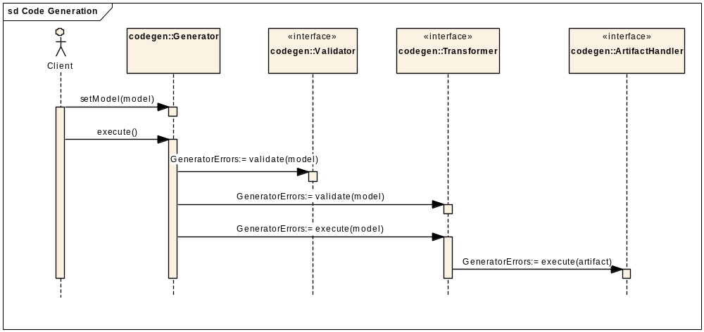
SDK 4.0 – Code Generation

Slide 4


Overview of the Artifacts
Artifact | 3.1/3.2 | 4.0
POJO Beans
SDK Java beans
Java beans Impl classes
WS beans
WS beans Impl classes
Unit test classes (JUnits) |  | *
O/R mapping file for the Java beans (*.hbm.xml)
O/R mapping file for the Impl classes
O/R configuration file (orm1.cfg.xml)

Slide 5
Overview of the Artifacts (cont)
Artifact | 3.1/3.2 | 4.0
Cache configuration file (ehcache.xml)
DAO Configuration file (DAOConfig.xml)
Domain objects list (coreBeans.properties)
Association mapping file (roleLookup.properties)
XML Schema files (XSD)
Castor mapping file
Web services deployment file (wsdd) |  | *

Slide 6
SDK 4.0 - Why so few artifacts?
Technology to the rescue
  JDK 1.5 – Typed collections
  Spring – Remoting interceptor and bean factory
  ACEGI – Security framework
  CGLIB – Dynamic proxy
  XFire – Annotation based web service
Architectural Changes
  Elimination of Impl classes
  Better design of the framework

Slide 7
SDK 4.0 – Generated System
Support for multiple Application Service
Support concurrent users
Provide Thick client and Remote client
Configurable security
Allow to use POJO beans and ORM files
Reduce caCORE deployment impact due to SDK design changes

Slide 8
SDK 3.2 Problems | SDK 4.0 Solution
Someone needs to hold reference to the application service(s) | Client holds reference to all the Application Services it asked for
Bean needs to know which application service to connect to in order to fetch association | Force beans to remember where it came from so that bean can fetch the association
List Proxy needs to know which application service to connect to in order to fetch objects | Force List Proxy to remember where it came from so that it can fetch next batch

Slide 9
SDK 4.0 – Beans
Simple POJOs
Use wrapper classes in the beans but UML model can specify primitives
Associations are Typed
No enforcement on the “id” attribute
“id” attribute determined from the primary key or the tag value

Slide 10
SDK 4.0 Beans - Advantage
Simple POJOs
Grid can seamlessly utilize the SDK generated beans
CGEMS team can take advantage of POJOs
We do not have to develop WS beans
Others can use their hand developed beans

Slide 11
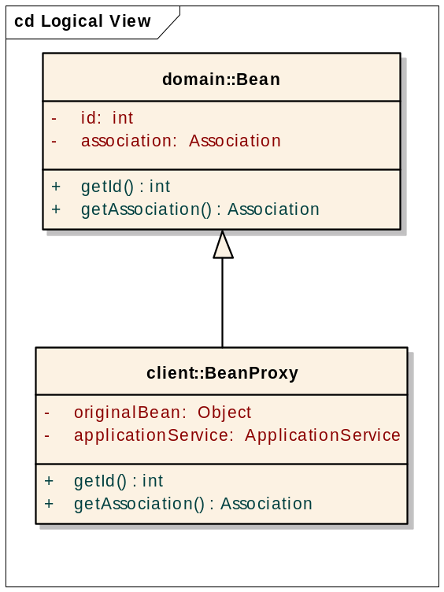
SDK 4.0 – Beans and Proxies

Slide 12
SDK 4.0 – Bean Proxy
Bean proxy knows where bean came from
Proxy contains a reference to the Application Service where it came from
Created on the client side at run-time by Application Service Proxy using CGLIB
Proxy creation transparent to the client

Slide 13
SDK 4.0 – List Proxy
List Proxy
Gene1
Gene2
Gene3
. .
Gene999
List Proxy
ApplicationServiceProxy
GeneProxy1
GeneProxy2
GeneProxy3
. .
GeneProxy999

Slide 14
SDK 4.0 – List Proxy
List proxy knows where list came from
List contains a reference to the Application Service where it came from
Application Service Proxy reference inserted on the client side

Slide 15
SDK 4.0 – ApplicationServiceProxy Client Side
Application Service is invoked by
  Client application
  Bean (to fetch association)
  List Proxy (to fetch next 1000 records)
Converts all the retrieved beans to bean proxy
Inserts the reference in the list proxy

Slide 16
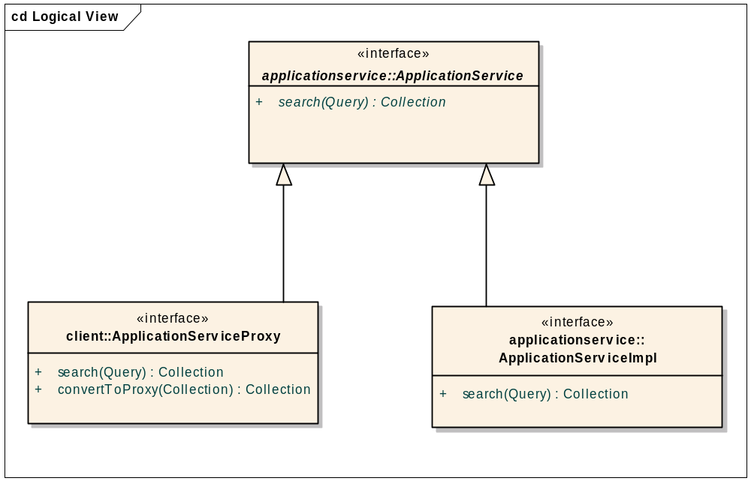
SDK 4.0 – ApplicationServiceProxy Client Side

Slide 17
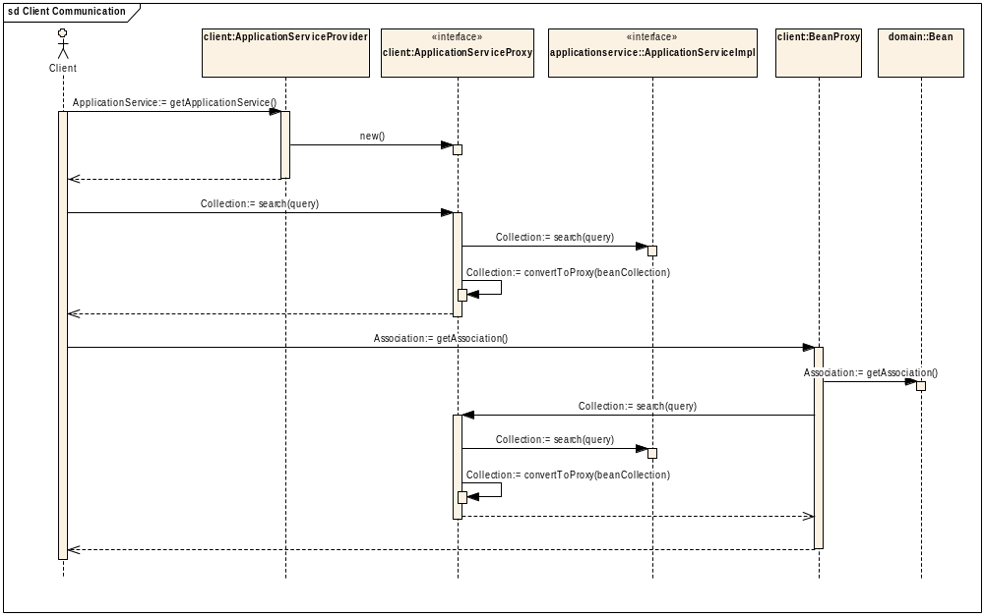
Client Server Communication
Bean Proxy Creation

Slide 18
SDK 4.0 - Application Service
Abstract class
4 Search methods
4 Query methods
4 writable API methods
1 Count query
Typical method signature
  Search(Query, targetClassName)
DAO selection is on targetClassName which can be spoofed

Slide 19
Proposed changes
Make Application Service an Interface
Change method signatures to
  Search(Query)
Determine DAO from the query

Slide 20
Non ORM Systems
Need to be aware of the bean proxy creation rules
  Default rule – Convert all non wrapper classes to proxy on specific methods
  Can be changed to work on the specified classes from external configuration file

Slide 21
What do we get at the end
Simple system which works on POJOs and regular O/R mapping files
Reduced deployment effect

Slide 22
SDK 4.0 - Security
External to the application
Seamless security context propagation from client to the server
Support concurrent users
Works with CSM authentication and authorization API

Slide 23
ACEGI Security Framework
Built on Spring framework
Open source
Widely accepted
Multiple ways of performing authentication

Slide 24
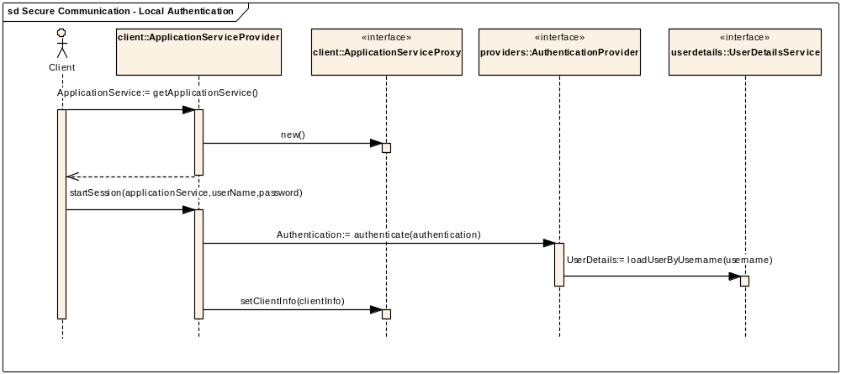
Local Authentication

Slide 25
CSM and ACEGI
ACEGI obtains the user from the UserDetailService to perform authentication
ACEGI-CSM bridge is required to perform authentication and authorization

Slide 26
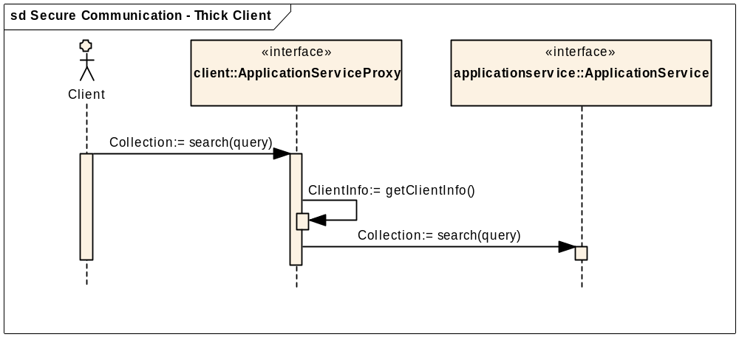
Secure Local Communication

Slide 27
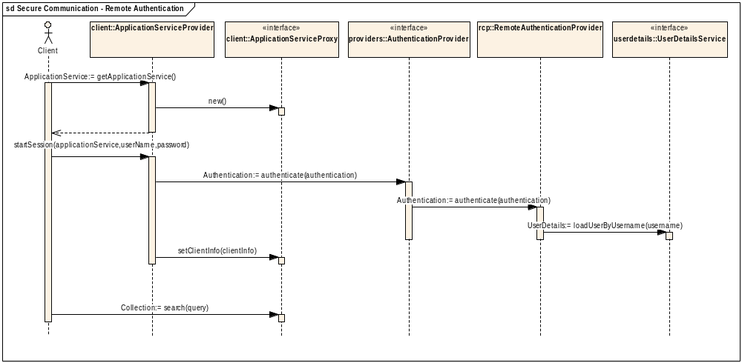
Remote Authentication

Slide 28
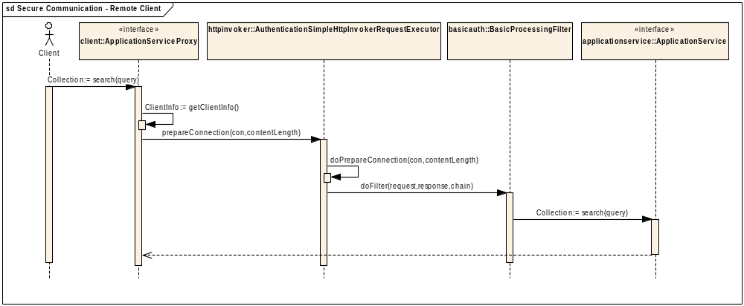
Secure Remote Communication

Slide 29
Authorization
Pluggable using AOP/AspectJ/Spring based interceptors on ApplicationService
Need to prototype

Slide 30
Questions

Slide 31
SDK 3.2: Architecture
Internet
Browser
HTTP
Filter
HTTP
Servlet
ORM
DAO
Custom Code
Java
Client
Proxy
Client
HTTP
Remoting
Servlet
Service
Proxy
Application Service
Webservice
Client
HTTP
Filter
Webservice
Non-ORM
DAO
SDK Clients
SDK Server API

Slide 32
SDK 3.2: Java Client
Java
Client
Custom Code
Application
Service
Client Impl
HTTP
Remoting
Client
HTTP
Remoting
Servlet
Application
Service
Server Impl
Application Service
Inserting
Security Token
As Parameter
Verifying
Security Token
From Parameter

Slide 33
SDK 3.2: Java Client Problems
Have to maintain three additional files
Difficult to introduce new methods
Security configuration requires rebuild of application
Security code is wired in the application

Slide 34
SDK 4.0: Java Client
Spring + ACEGI
Java
Client
Open Source Tools
Spring HTTP
Remoting
Client
ACEGI
Security
Interceptor
ACEGI
HTTP
Filter
Spring HTTP
Remoting
Servlet
Application Service
Inserting User
Credentials
(BASIC
Authentication)
Verifying
Authentication
From HTTP
Header

Slide 35
SDK 4.0: Java Client
Allow to use multiple methods of authentication and authorization
No need to maintain additional source code
New methods can be easily introduced
Security configuration is external to application code

Slide 36
SDK 4.0: Web Tier
Browser
ACEGI HTTP
Filter
HTTP
Servlet
Application Service
Inserting User
Credentials in
Cookie
Verifying
Authentication
from Cookie

Slide 37
SDK 4.0: Webservice
Webservice
Client
HTTP
Filter
Spring
Webservices
Servlet
Application Service
Inserting User
Credentials in
Header
Verifying
Authentication
from SOAP
Header

Slide 38
SDK 4.0: Architecture
Internet
Browser
HTTP
Servlet
ORM
DAO
Java
Client
Open Source
Tools
HTTP
Remoting
Servlet
Application Service
Webservice
Client
Spring
Webservice
Servlet
Non-ORM
DAO ??
SDK Clients
SDK Server API

Slide 39
SDK 3.2: Architecture
Internet
Browser
HTTP
Filter
HTTP
Servlet
ORM
DAO
Custom Code
Java
Client
Proxy
Client
HTTP
Remoting
Servlet
Service
Proxy
Application Service
Webservice
Client
HTTP
Filter
Webservice
Non-ORM
DAO
SDK Clients
SDK Server API

Slide 40
Questions

Slide 41
SDK 4.0: Web Application
Based on NCICB UI templates
Section 508 Compliant
Struts based application
User can specify views for each object
Allow to specify parameters on associated objects
Allows to build complex queries
  Logical operators in search criteria
  Perform ordering

Slide 42
SDK 4.0: Web Application
Allow to edit the existing record
Allow to sort the search results
Allow to create new records ??

Slide 43
SDK 4.0: New Features
Allow to specify Lazy fetch for association
JDK 5 Based implementation
  Support for typed collection
  Support for enumeration
  Support for interfaces
Instance level security
Attribute level security

Slide 44


Java Client Application
Browser
(HTML/JavaScript)
Web Services
Client Application
Remoting Client
(Spring)
Thick Client
Security Filters
Web Tier
(JSP/Struts)
Web Services
(Axis)
Remoting
(Spring)
Business Tier
(Application Service / List Proxy / Query Translators / Security)
Request
(HQL/Detached Criteria)
Response
(Collection of Domain Obj)
Authenticate/ Authorize
Persistence Tier
(Hibernate)
Security API
(CSM)

Slide 45
SDK 3.2: Code Generation
Steps of code generation
  Compile codegen source code
  Compile JET Templates
  Execute Codegen for each artifact against XMI
JDK 1.4 based artifacts
Takes about 30 minutes for caCORE API
Difficult to debug problems in code generation

Slide 46
SDK 3.2: Generated Artifacts
Java Beas and Impl Classes
WS Beans and WS Impl Beans
ORM Files and ORM Impl Files
ORM Config File
DAO Config File
EHCache Config File
RoleLookup.Properties
CoreBeans.Properties
JUnits
XSD and Castor Mapping Files

Slide 47
SDK 4.0: Code Generation
Steps
  Compile codegen source code
  Compile JET Templates
  Build codegen.jar file
  Execute codegen.jar once against XMI file for all artifacts to be produced
JDK 1.5 based beans and artifacts
Estimated execution time <5min for caCORE API
Easier to debug

Slide 48
SDK 4.0: Generated Artifacts
Java Beas
ORM Files
Spring ORM Config File
SDK Config File
EhCache Config File
JUnits
XSD and Castor Mapping Files

